Slide 1
UI/UX for Skippy’s Gold
by. Team Prototype (Group 24)

Slide 2
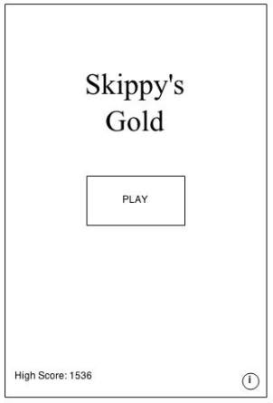
Main Menu
Simple and thumb-friendly “Play” button
Artwork of Skippy The Pirate
High Score
Information button

Slide 3
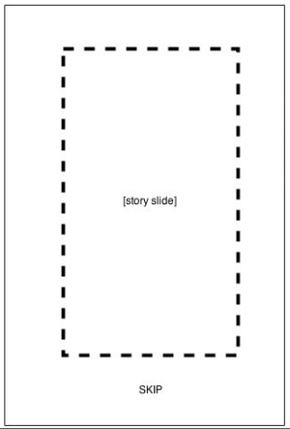
Story/Instructions Slides
3 Slides which tell the story of Skippy
1-2 Slides which explain how to play the game
Skip option available

Slide 4
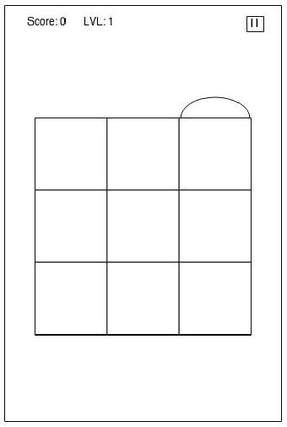
Play Screen
Interactive grid system
Info bar across the top of the screen

Slide 5
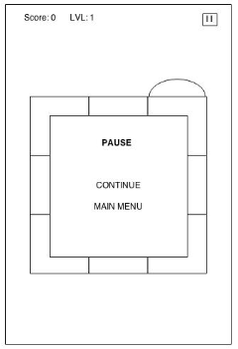
Pause Screen
Pause button opens a mini menu
Options are “Continue” and “Main Menu”

Slide 6
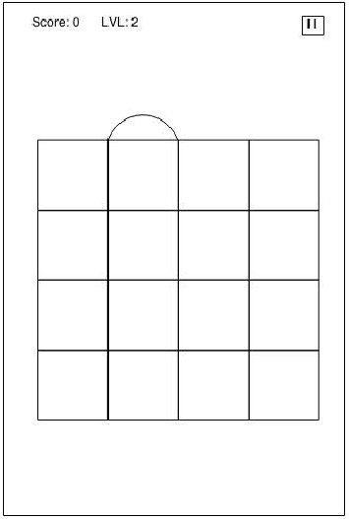

Slide 7
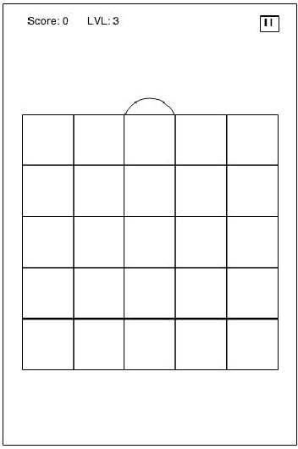

Slide 8
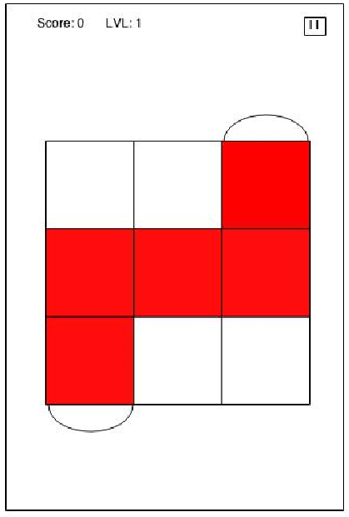

Slide 10
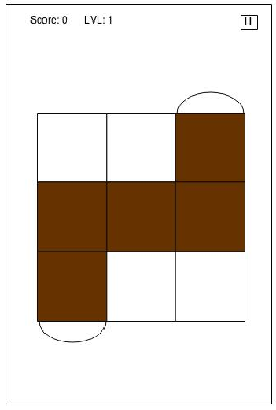

Slide 11
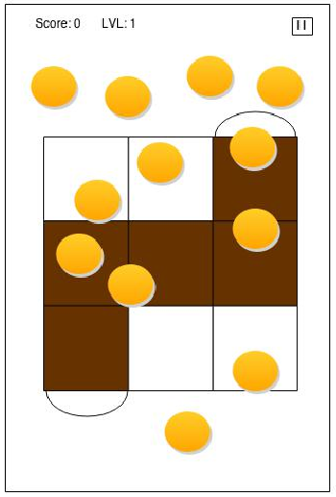

Slide 12
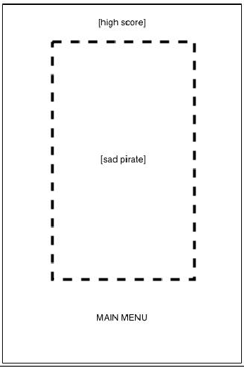
Lose Screen
Contains main menu button
Artwork of skippy the pirate
Score emphasized

Slide 13
Thank you!
Questions?

